Slide 1


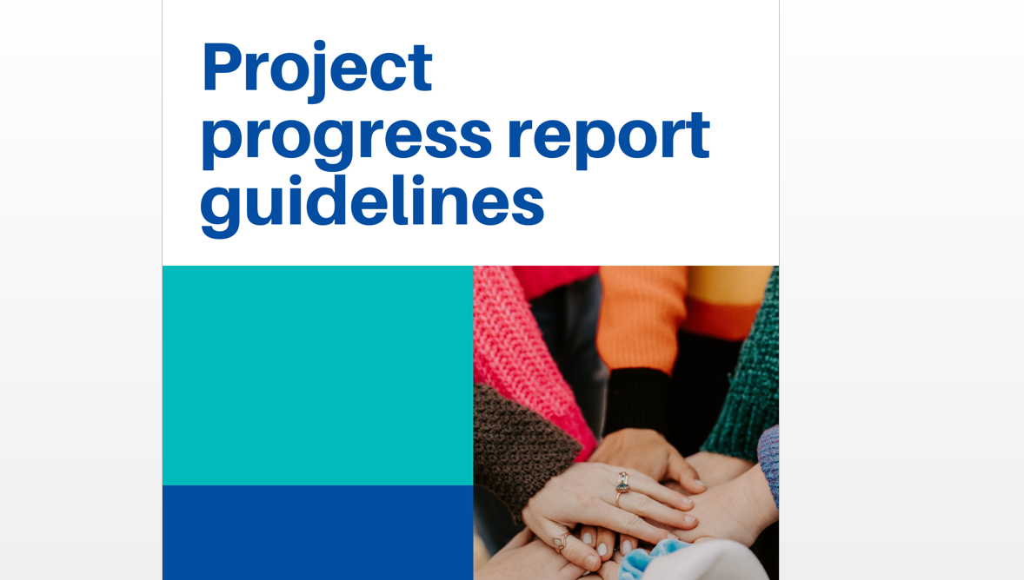
PAC/DSP implementation framework
Reporting in Jems
Online seminar 4th December 2023

Slide 2
Status of PAC/DSP projects December 2023
All projects contracted and operating
Status in Jems: “Contracted” (reporting possible)
Submission of the 1st PPR (covering entire 2023): 1st April 2024
Major project changes possible only “outside” Jems (related module under development)
Minor changes possible any time (handled “outside” Jems anyway, in most cases)

Slide 3
Reporting Framework
Half-yearly reporting periods (except first 2 periods, which were merged)
2-yearly reviews
All other processes very similar to those under DTP/eMS
Crucial documents:
DRP Implementation Manual (section 4)
Guidelines (for PPR and PR)
DRP control guidelines

Slide 4
Reporting Periods
Report Nr. SC | Report Nr. jEMS | Timeframe | Submission
1 | 1 | 01/01/2023–31/12/2023 | 15/01/2024
 | 2
2 | 3 | 01/01/2024-30/06/2024 | 15/07/2024
3 | 4 | 01/07/2024-31/12/2024 | 15/01/2025
4 | 5 | 01/01/2025-30/06/2025 | 15/07/2025
5 | 6 | 01/07/2025-31/12/2025 | 15/01/2026
6 | 7 | 01/01/2026-30/06/2026 | 15/07/2026
7 | 8 | 01/07/2026-31/12/2026 | 15/01/2027
8 | 9 | 01/01/2027-30/06/2027 | 15/07/2027
9 | 10 | 01/07/2027-31/12/2027 | 15/01/2028
10 | 11 | 01/01/2028-30/06/2028 | 15/07/2028
11 | 12 | 01/07/2028-31/12/2028 | 15/01/2029

Slide 5
Reporting Process
e.g. 31st December
Verification process | Verification timeframe and indicative deadlines
Preparation and submission of the partner report by the project partner to the controller from the end of each reporting period | 15 days
Verification of expenditure and issuing the control certificate by the controller |  | 60 days
Preparation and submission of the PPR and the AfR for the whole project by the lead partner to the MA/JS |  |  | 15 days
1st April

Slide 6
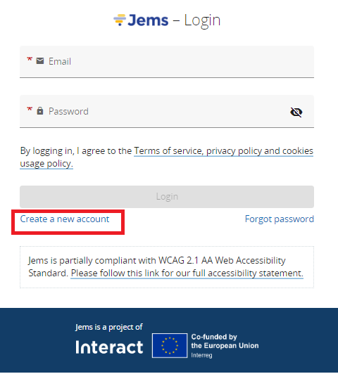
Partner Reports
LP needs to assign users for project partners, otherwise creating partner reports in JEMS is not possible (it is not active). Assignment is in JEMS Project privileges section.
  Only already registered JEMS users can be assigned to project partners, meaning that PPs needs to Create an account in JEMS and to inform the LP about it.

Slide 7
Partner Reports
Start reporting in JEMS with period 2 (because first period in SC is for one year while in JEMS reporting periods are for 6 months)
Observe eligibility rules and payment deadline (end of the reporting period)
Prepare and Submit the partner report by 15.01.2024
Make sure there is a Control institution assigned in JEMS to the partner in JEMS Project Privileges section. In case of missing Control Institution, please message your National Control

Slide 8
Status of Partner Reports
Follow the status of the partner report in JEMS
In case completions are needed status is for Reopened.
Fulfill completions and resubmit the partner report
Use the Attachment section to relay various documents to National Control: SC, minor modifications, proof on outputs

